Slide 1
Title: AI-Based Student Performance System Using Machine Learning & Real-Time Analytics
PRESENTED BY : RAHISH KUMAR
COURSE : B.TECH IT & DATA SCIENCE
SEMESTER : VI
URN NO : 2023-B-04032005C
Submission Date: 31-03-2026

Slide 2
Problem Statement
Challenges in Traditional Performance Analysis
Student performance analysis is mostly done manually, making it slow and inefficient.
Educational data is scattered across Excel files, databases, and paper records.
No centralized system to manage and monitor student performance.
Lack of real-time tracking leads to delayed intervention for weak students.
No predictive tools to identify at-risk students in advance.
Decision-making becomes slow due to time-consuming processes

Slide 3
Technologies & Implementation Stack
Python & Streamlit – Used to build interactive web application
Firebase Authentication – Provides secure login and user management
Google Sheets API – Enables real-time cloud data storage and updates
Linear Regression Model – Used for predicting student marks
Power BI Integration – Provides advanced dashboards and analytics
API Integration – Connects all systems and ensures smooth data flow

Slide 4
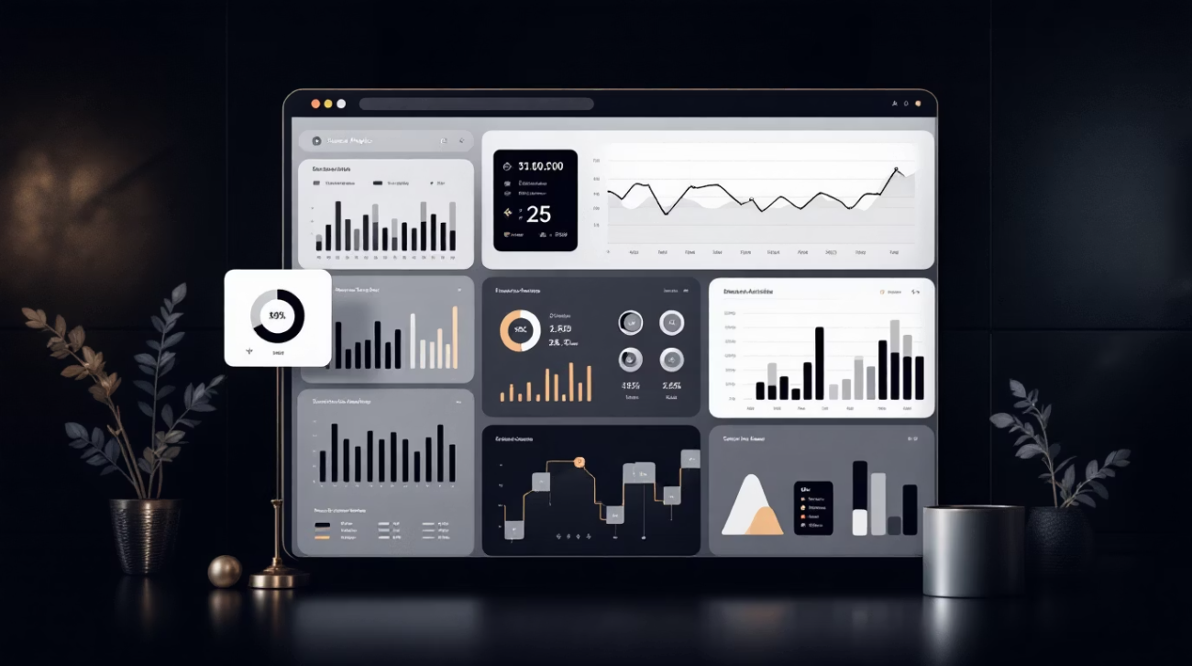
Project Objectives
To centralize student performance data from multiple sources
To analyze and process student data efficiently
To implement machine learning for predicting student marks
To develop an interactive dashboard for visualization
To enable data-driven decision-making for institutions
To build a scalable and user-friendly system

Slide 5
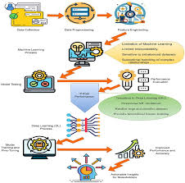
Machine Learning Model Architecture
The system uses a Linear Regression algorithm
Purpose: To predict student marks based on study hours
Input Variable: Study Hours
Output Variable: Marks
Model is trained using historical student data
Provides fast and simple predictions for analysis
👉 Formula: Marks = m × Study Hours + c

Slide 6
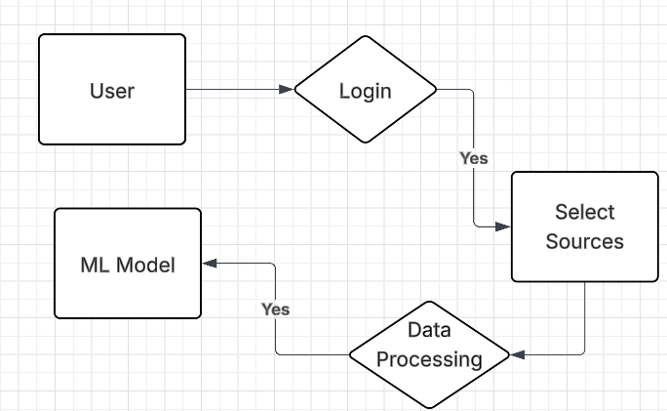
System Architecture & Data Flow
Flow: User → Login → Select Data Source → Data Processing → ML Model → Dashboard
User logs into the system securely
Data is selected from Google Sheets or CSV file
Data is processed and cleaned
Machine learning model generates predictions
Results are displayed on dashboard and Power BI

Slide 7
Key Features & Capabilities Real-Time Analytics
Real-time analytics using live data
Machine learning-based prediction system
Integration of multiple data sources
Secure authentication using Firebase
Modern UI with dark theme and animations
Advanced visualization using Power BI
Live data fetching from Google Sheets
Auto-refresh functionality for updated data
Instant updates without manual reload
Helps in quick decision-making
Provides continuous monitoring of student performance

Slide 8
Predictive Analysis Data Integration
Supports multiple data sources
Google Sheets for real-time cloud data
CSV upload for offline data
Flexible and easy data management
Ensures seamless data flow across system
Uses machine learning to predict student marks
Based on study hours and historical data
Helps identify weak and strong students
Supports early intervention strategies
Improves academic performance tracking

Slide 9
Secure Authentication Modern UI & Dashboard
Firebase-based authentication system
Secure login and signup functionality
Email and password-based access
Protects user data and privacy
Prevents unauthorized system access
Dark theme for professional look
Gradient styling for visual appeal
Lottie animations for better interaction
Clean and minimal interface design
Easy navigation and user-friendly experience

Slide 10
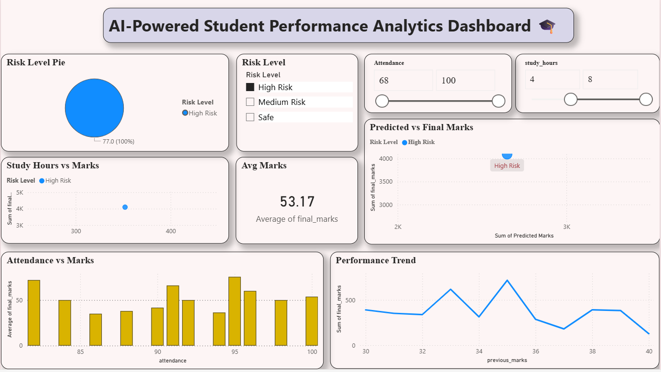
Power BI Dashboards
Advanced data visualization
Interactive reports and charts
Easy-to-understand insights
Embedded Power BI dashboard
Helps in better decision-making

Slide 11

Limitations Future Scope
Requires continuous internet connection
Uses basic ML model (Linear Regression)
Firebase free-tier limitations
Accuracy depends on data quality
Cannot capture complex patterns in data
Implementation of advanced AI & Deep Learning models
Development of mobile application
Student ranking and recommendation system
Notification and alert system
Integration with institutional databases (ERP systems)

Slide 12
Conclusion & Acknowledgement
Successfully developed a real-time student analytics system
Implemented machine learning for prediction
Integrated Power BI for advanced visualization
Built a scalable and efficient system
Improved decision-making using data analytics
Thank you
Thank you for your attention.

